Slide 1
DBS201: Entity Relationship Diagram
Lecture 3

Slide 2
Agenda
Entity Relationship Model
Discovering Entities

Slide 3
Entity Relationship Diagram
Shows entities – similar to a table structure
An entity is an object that exists and is distinguishable from other objects
An entity is represented by a set of attributes
An attribute has a domain (i.e. a set of permitted values)
Entities are associated by relationships

Slide 4
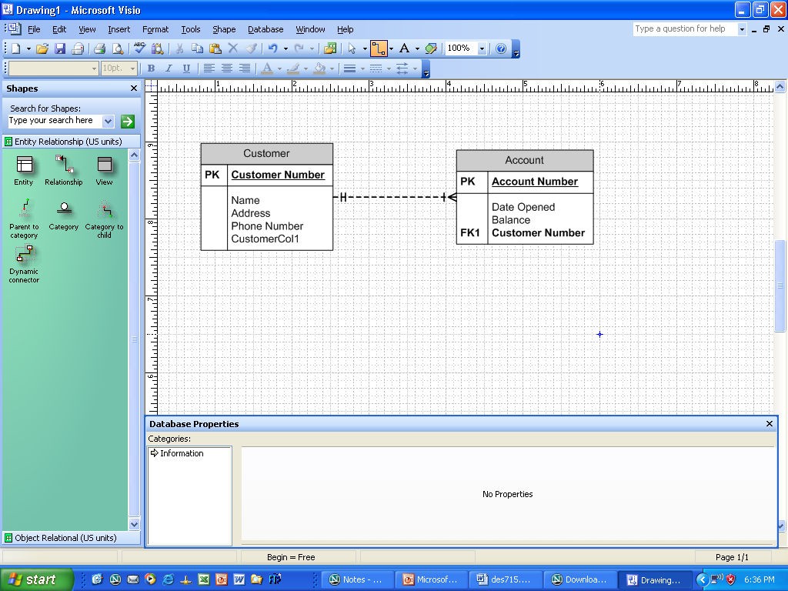
Entity Relationship Diagram
Sample ERD
Entity Name
Primary key notation
Attributes
Relationship
Foreign key notation
Entity

Slide 5
Relationships
1:1 relationship
  Does not occur very often
1:M relationship
  Relational modeling ideal
M:N relationships
  Must be avoided because they lead to data redundancies

Slide 6
Relationships
1:1 Relationship
  One entity can be related to only one other entity, and vice versa
  Often means that entity components were not defined properly
  Could indicate that two entities actually should be one entity
  Sometimes 1:1 relationships are appropriate

Slide 7
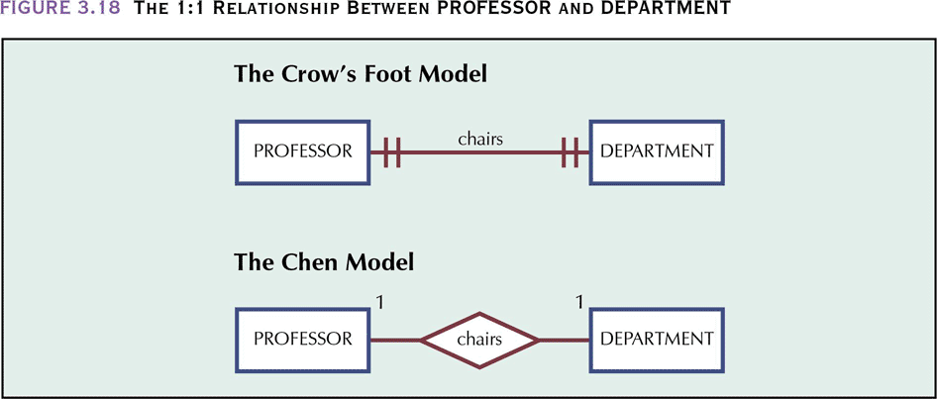
Relationships

Slide 8
Relationships
1:M Relationship
  One instance of an entity A can be related to zero or more of entity B and one instance of a entity B can be related to only 1 instance of an entity A.
  Natural type of relationship – very common

Slide 9
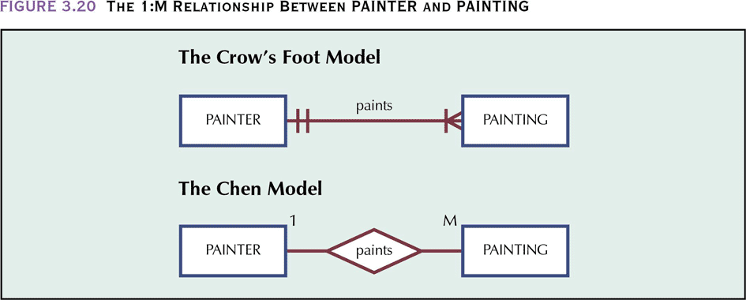
Relationships

Slide 10
Relationships
M:N Relationship
  Can be implemented by breaking it up to produce a set of 1:M relationships – a composite or bridge entity which converts an M:N relationship into two 1:M relationships
  Additional attributes may be assigned as needed

Slide 11
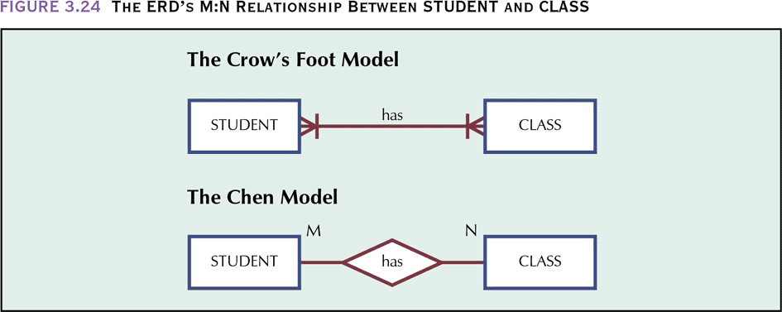
Relationships

Slide 12
Agenda
Entity Relationship Model
Discovering Entities

Slide 13
Discovering Entities
Remember requirements gathering approaches?
Different approaches: bottom-up/top-down
Top-down uses an overview/narrative of a system to discover entities
Bottom-up uses screen/report samples to discover attributes, then these are grouped into entities

Slide 14
Discovering Entities
Top-down:
  Given an overview (narrative) of system functionality, compile a list of major entities the system needs to know about
  An entity is anything such as a person, place, thing or event about which data are to be collected and stored
  Ignore the characteristics of those things i.e. if you know you need data about a customer, ignore name, date of birth (for now…)

Slide 15
Discovering Entities
Top-down Example:
  Given the following narrative, identify the key entities
  A Librarian wishes to make inquiries about borrowing activity within a library. The librarian can inquire about specific books borrowed by a customer using either their account or name. An inquiry can also be made by book category (such as fantasy, children’s, reference, etc) or an inquiry can be made that will look at the titles of a specific book.

Slide 16
Discovering Entities
Create an ERD from the following description:
  A department employs many employees, but each employee is employed by one department.
  A division operates many departments, but each department is operated by one division.
  An employee may be assigned to many projects, and a project may have many employees assigned to it.

Slide 17
Discovering Entities
Top-down Example:
  Given the following narrative, identify the key entities
  Multiple Real Estate Listing Service (MRELS) is a company that has offices throughout Southern Ontario. These offices have a number of Real Estate agents working for them. MRELS deals in both residential and commercial real estate. Agents work with customers to get a listing or to find a listing for a customer. A listing will include the address and the type of property (residential or commercial), square footage, annual taxes and closing date. If it is a residential property, it will include number of bedrooms, number of bathrooms, special features (central air, heated by gas or oil, radiators or forced air, for instance). For a commercial property, it will include number of offices as well as number of docking bays (where trucks back up to be loaded/unloaded).

